Slide 1
CS 447/647
Containers

Slide 2
Containers
Standardize software packaging
Modern applications have a lot of components and dependencies.
Code
Libraries
NCR ReactJS application has > 500 dependencies
Interpreter (Python or Ruby), Java Runtime Environment, and unique services
Versions matter
python36, python37, python38
OpenJDK 8 - 10
Localizations, accounts, and environment settings
Large organizations have dozens of these applications
Conversion from VMs to containers
download.cse.unr.edu, ncr-remote.cse.unr.edu, git.cse.unr.edu, ph.engr.unr.edu, mx0.engr.unr.edu

Slide 3
Container Images
Packages application(s) into a file.
Similar to a chroot
Repositories of common OS (singularity URL)
docker://centos:8
docker://debian:buster
Fat - Contains entire OS and “boots”
Thin - runs just an application
Copy and Paste Portability

Slide 4



Chapter 25
The book focuses on:
Docker
Other common containerization technologies:
Podman
systemd-nspawn
Lowest level container system
Effectively a robust chroot solution
LXC - FOSS container system
Incus - Community developed
LXD - Developed by Canonical (Ubuntu)
Apptainer (Singularity) - HPC containers
Focuses on portability
Developed at LLNL

Slide 5
Core Concepts
Fusion of existing kernel features
Container systems tie them all together
Makes the features easy to use
A container system should
Create and configure virtual Ethernet devices
Isolate processes
chroot the filesystem
Manage the storage volumes
Restrict resources (CPU, RAM, Networking)
Handle creation, starting, stopping and destruction
Maybe backups

Slide 6
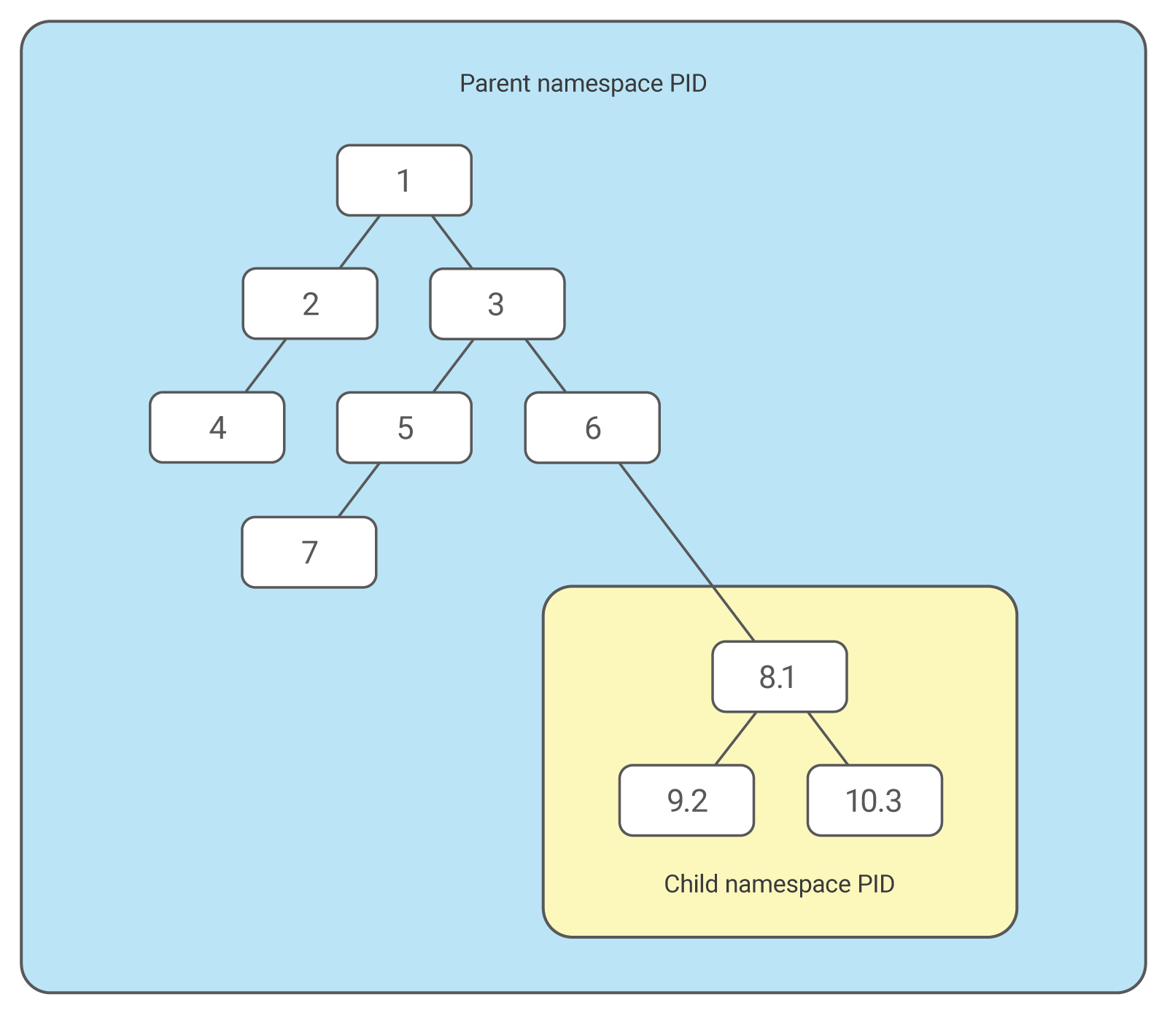
Kernel Support - Features
Namespaces (2002) - partitions resources by process
Control Groups (2007) - restrict resources like RAM
Capabilities(1999) - Independent kernel capabilities
CAP_SYS_CHROOT - Allows chroot(2) to be used.
CAP_NET_ADMIN - Allows changes to network system.
man 7 capabilities
Secure Computing Mode (2005) - restricts syscall access
/proc/PID/seccomp = 1
Process can only: read, write, exit and sigreturn

Slide 7

namespaces
man 2 clone
used by fork
CLONE_NEWNS (since Linux 2.4.19)
Start the child in a new mount namespace.
CLONE_NEWNET
Start child in a new network namespace
CLONE_NEWPID
create the process in a new PID namespace

Slide 8
7 namespaces
Mount - isolate filesystem mount points
UTS - isolate hostname and domainname
IPC - isolate interprocess communication (IPC) resources
PID - isolate the PID number space
Network - isolate network interfaces
User - isolate UID/GID number spaces
https://manpages.debian.org/buster/passwd/subuid.5.en.html
Cgroup - isolate cgroup root directory

Slide 9
control groups
Restrict resources of a process Cores [0,1,2,3]
CPU time in microseconds
100000 is the default
Memory
Network
Block IO
ad-hoc commands
mount | grep cgroup #Created for use by systemd, Memory=2G

Slide 10
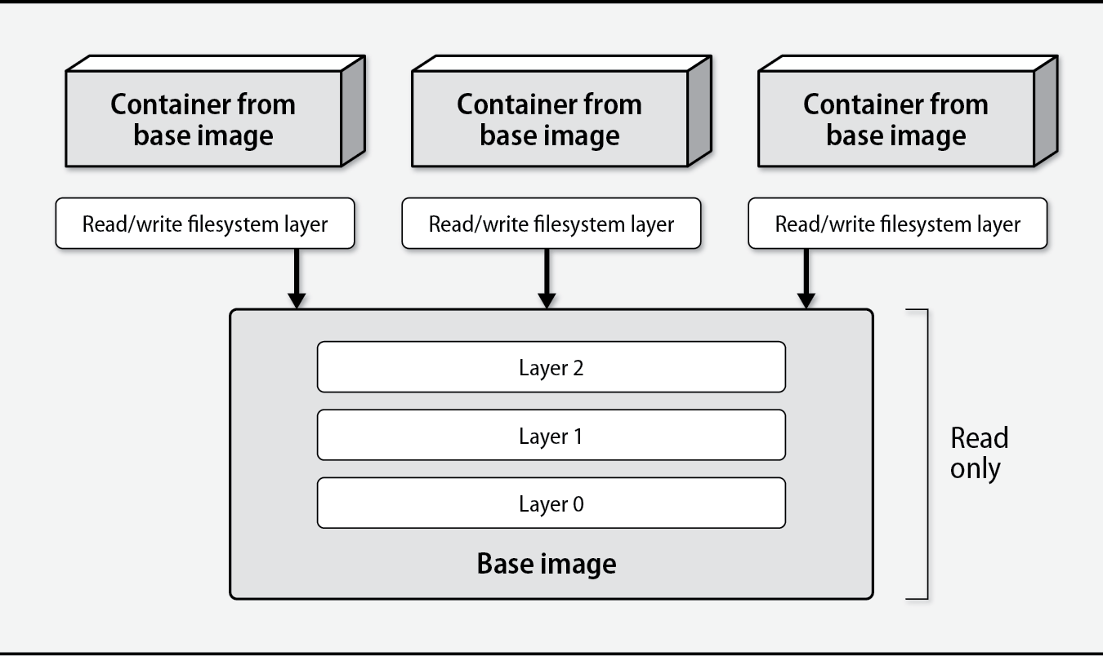
Images

Slide 11
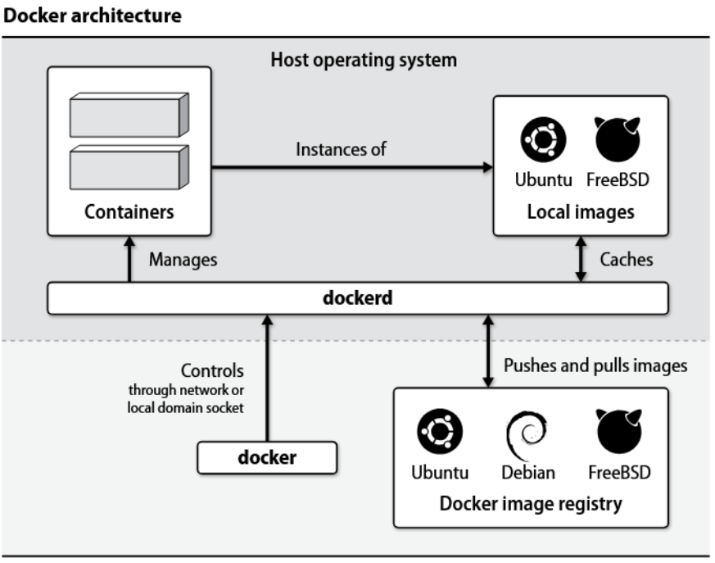

Slide 12
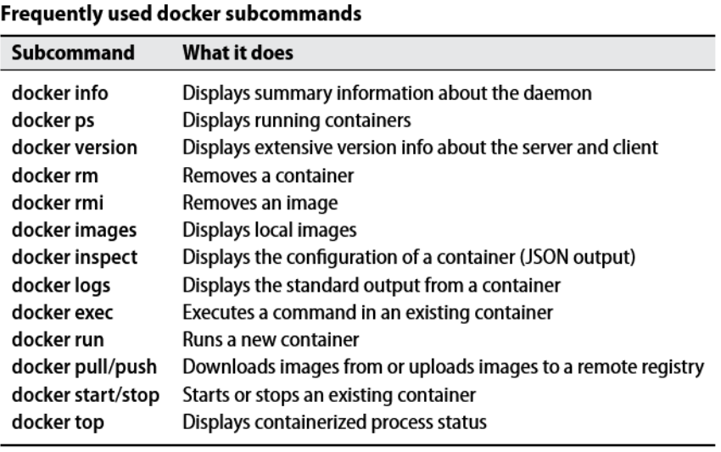

Slide 13
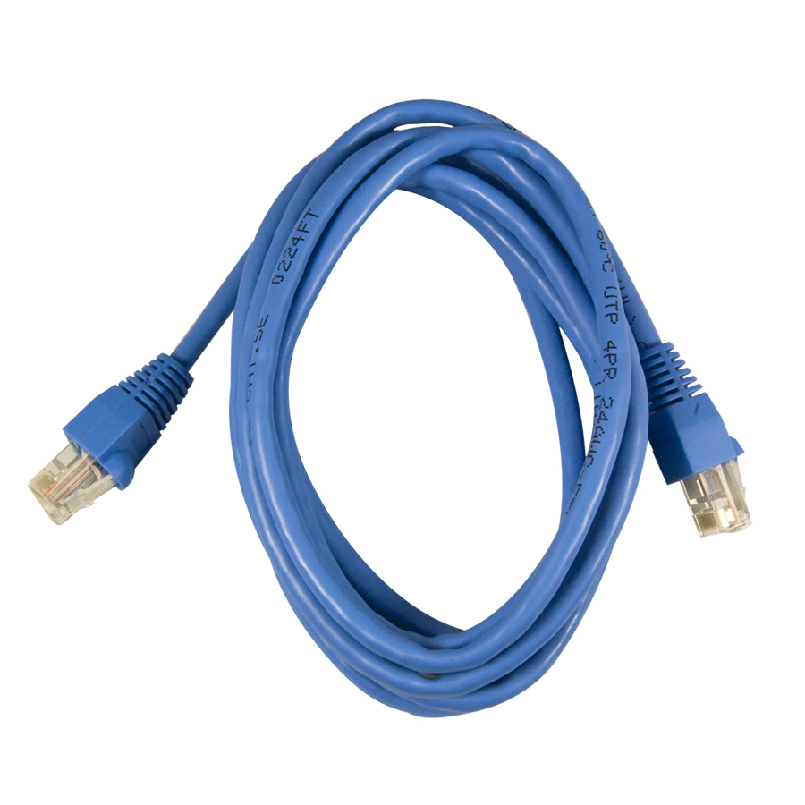
Networking
Virtual Ethernet Device (veth)
Tunnel between network namespaces
Pairs
ip link add <p1-name> type veth peer name <p2-name>
ip link set <p2-name> netns <p2-namespace>
p1-name
p2-name

Slide 14
Setting up Apptainer/Singularity
Why?
Unique Security
Untrusted users
Untrusted containers
Runs as user account
Less isolation
Focuses on portability and integration
By default it only isolated the mount points
https://sylabs.io/guides/3.7/user-guide/quick_start.html

Slide 15
Using singularity(1)
#Build a simple Ubuntu images singularity build ubuntu.sif docker://ubuntu #Not terribly useful
#Sandbox singularity build --sandbox ubuntu docker://ubuntu
#Customize singularity shell --writable ubuntu/ apt update -y && apt install -y emacs
#Build into a portable .sif singularity build ubuntu.sif ubuntu/

Slide 16
Singularity Features
Encrypted containers
Encrypted filesystem
Keys or Passphrase
GPU Support
Persistent Overlays
Easy to transport modifications
immutable container image (default)
preserves environment
Bind Mounting
Mount a directory from the host in a container
-B /src:/dst
Services
singularity instance start <some.sif>

Slide 17
systemd-nspawn
No frills containers, similar to chroot
Create your own network bridge
Configure your own chroot or raw image
Create nspawn config
Create systemd service file
machinectl(1) to manage lifecycle
apt install systemd-container

Slide 18
Getting started
brctl addbr br0
#chroot debootstrap --arch=amd64 --include=systemd-container sid postfix
#.nspawn conf /etc/systemd/nspawn/postfix.nspawn
#Run it systemd-nspawn -D postfix -b -M c1 machinectl login # or machinectl shell

